Slide 1
INFORMATION SYSTEMS SECURITY, CONTROL AND AUDIT
Information Systems Security
RISK MANAGEMENT: CONTROLLING RISK
Week 8

Slide 2
Learning Objectives
  Understand and select from the risk mitigation strategy options to control risk
  Identify the risk control classification categories
  Use existing conceptual frameworks to evaluate risk controls, and formulate a cost benefit analysis
  Maintain and perpetuate risk controls
Notes:
Learning Objectives
Understand and select from the risk mitigation strategy options to control risk
Identify the risk control classification categories
Use existing conceptual frameworks to evaluate risk controls, and formulate a cost benefit analysis
Maintain and perpetuate risk controls

Slide 3
Introduction
To keep up with the competition, organizations must design and create a safe environment in which business processes and procedures can function
This environment must maintain confidentiality and privacy and assure the integrity and availability of organizational data
These objectives are met via the application of the principles of risk management
Notes:
Introduction
To keep up with the competition, organizations must design and create a safe environment in which business processes and procedures can function.
This environment must maintain confidentiality and privacy and assure the integrity and availability of organizational data.
These objectives are met via the application of the principles of risk management.

Slide 4

Risk Control Strategies
An organization must choose one of four basic strategies to control risks
  Avoidance: applying safeguards that eliminate or reduce the remaining uncontrolled risks for the vulnerability
  Transference: shifting the risk to other areas or to outside entities
  Mitigation: reducing the impact should the vulnerability be exploited
  Acceptance: understanding the consequences and accepting the risk without control or mitigation
Notes:
Risk Control Strategies
An organization must choose one of four basic strategies to control risks :
Avoidance: applying safeguards that eliminate or reduce the remaining uncontrolled risks for the vulnerability
Transference: shifting the risk to other areas or to outside entities
Mitigation: reducing the impact should the vulnerability be exploited
Acceptance: understanding the consequences and accept the risk without control or mitigation

Slide 5
Avoidance
Avoidance is the risk control strategy that attempts to prevent the exploitation of the vulnerability
Avoidance is accomplished through:
  Application of policy
  Application of training and education
  Countering threats
  Implementation of technical security controls and safeguards
Notes:
Avoidance
Avoidance is the risk control strategy that attempts to prevent the exploitation of the vulnerability.
Avoidance is accomplished through:
Application of policy
Application of training and education
Countering threats
Implementation of technical security controls and safeguards

Slide 6
Transference
Transference is the control approach that attempts to shift the risk to other assets, other processes, or other organizations
This may be accomplished by rethinking how services are offered, revising deployment models, outsourcing to other organizations, purchasing insurance, or by implementing service contracts with providers
Notes:
Transference
Transference is the control approach that attempts to shift the risk to other assets, other processes, or other organizations.
This may be accomplished by rethinking how services are offered, revising deployment models, outsourcing to other organizations, purchasing insurance, or by implementing service contracts with providers.

Slide 7
Mitigation
Mitigation is the control approach that attempts to reduce, by means of planning and preparation, the damage caused by the exploitation of vulnerability
This approach includes three types of plans:
  Disaster recovery plan (DRP)
  Incident response plan (IRP)
  Business continuity plan (BCP)
Mitigation depends upon the ability to detect and respond to an attack as quickly as possible
Notes:
Mitigation
Mitigation is the control approach that attempts to reduce, by means of planning and preparation, the damage caused by the exploitation of vulnerability.
This approach includes three types of plans:
the disaster recovery plan (DRP),
incident response plan (IRP), and
business continuity plan (BCP).
Mitigation depends upon the ability to detect and respond to an attack as quickly as possible.

Slide 8
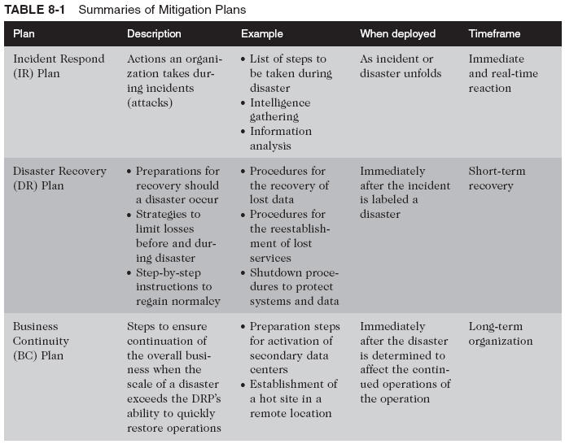
Summaries of Mitigation Plans
Slide <number>

Slide 9
Acceptance
The choice to do nothing to protect an information asset and to accept the loss when it occurs
This control, or lack of control, assumes that it may be a prudent business decision to examine the alternatives and conclude that the cost of protecting an asset does not justify the security expenditure
Notes:
Acceptance
As described above, mitigation is a control approach that attempts to reduce the impact of an exploited vulnerability.
In contrast, acceptance of risk is the choice to do nothing to protect an information asset and to accept the outcome from any resulting exploitation.
This control, or lack of control, assumes that it may be a prudent business decision to examine the alternatives and conclude that the cost of protecting an asset does not justify the security expenditure.
The only valid use of the acceptance strategy occurs when the organization has:
Determined the level of risk to the information asset
Assessed the probability of attack and the likelihood of a successful exploitation of a vulnerability
Approximated the ARO of the exploit
Estimated the potential loss from attacks
Performed a thorough cost benefit analysis
Evaluated controls using each appropriate type of feasibility
Decided that the particular asset did not justify the cost of protection

Slide 10
Acceptance (continued)
The only valid use of the acceptance strategy occurs when the organization has:
  Determined the level of risk to the information asset
  Assessed the probability of attack and the likelihood of a successful exploitation of a vulnerability
  Approximated the ARO of the exploit
  Estimated the potential loss from attacks
  Performed a thorough cost benefit analysis
  Evaluated controls using each appropriate type of feasibility
  Decided that the particular asset did not justify the cost of protection

Slide 11
Managing Risk
Risk appetite (also known as risk tolerance) defines the quantity and nature of risk that organizations are willing to accept, as they evaluate the trade-offs between perfect security and unlimited accessibility
The reasoned approach to risk is one that balances the expense (in terms of finance and the usability of information assets) against the possible losses if exploited

Slide 12

Managing Risk (continued)
When vulnerabilities have been controlled as much as possible, there is often remaining risk that has not been completely removed, shifted, or planned for; in other words, residual risk
“Residual Risk is a combined function of (1) a threat less the effect of threat-reducing safeguards; (2) a vulnerability less the effect of vulnerability-reducing safeguards, and (3) an asset less the effect of asset value-reducing safeguards.”

Slide 13
Managing Risk (continued)
The goal of information security is not to bring residual risk to zero, but to bring it in line with an organization’s risk appetite
If decision makers have been informed of uncontrolled risks and the proper authority groups within the communities of interest decide to leave residual risk in place, then the information security program has accomplished its primary goal

Slide 14
Evaluation, Assessment, and Maintenance of Risk Controls
Once a control strategy has been selected and implemented, the effectiveness of controls should be monitored and measured on an ongoing basis to determine its effectiveness and the accuracy of the estimate of the risk that will remain after all planned controls are in place
Notes:
Evaluation, Assessment, And Maintenance Of Risk Controls
Once a control strategy has been selected and implemented, the effectiveness of controls should be monitored and measured on an ongoing basis to determine its effectiveness and the accuracy of the estimate of the risk that will remain after all planned controls are in place.

Slide 15
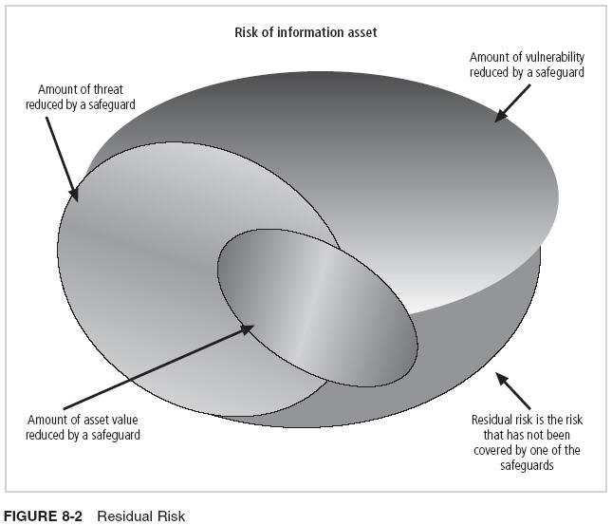
Residual Risk

Slide 16
Risk Control Strategy Selection
Risk control involves selecting one of the four risk control strategies for the vulnerabilities present within the organization
If the loss is within the range of losses the organization can absorb, or if the attacker’s gain is less than expected costs of the attack, the organization may choose to accept the risk
Otherwise, one of the other control strategies will have to be selected
Notes:
Risk Control Strategy Selection
Risk control involves selecting one of the four risk control strategies for the vulnerabilities present within the organization.
If the loss is within the range of losses the organization can absorb, or if the attacker’s gain is less than expected costs of the attack, the organization may choose to accept the risk.
Otherwise, one of the other control strategies will have to be selected.

Slide 17
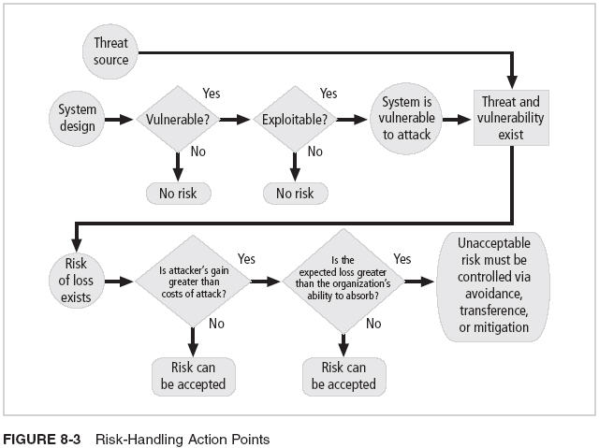
Risk Handling Action Points

Slide 18
Risk Control Strategy Selection
Some rules of thumb:
  When a vulnerability exists: Implement security controls to reduce the likelihood of a vulnerability being exercised
  When a vulnerability can be exploited: Apply layered controls to minimize the risk or prevent occurrence
  When the attacker’s potential gain is greater than the costs of attack: Apply protections to increase the attacker’s cost, or reduce the attacker’s gain, using technical or managerial controls
  When potential loss is substantial: Apply design controls to limit the extent of the attack, thereby reducing the potential for loss
Notes:
Risk Control Strategy Selection
Some rules of thumb on strategy selection are:
When a vulnerability exists: Implement security controls to reduce the likelihood of a vulnerability being exercised.
When a vulnerability can be exploited: Apply layered controls to minimize the risk or prevent occurrence.
When the attacker’s potential gain is greater than the costs of attack: Apply protections to increase the attacker’s cost, or reduce the attacker’s gain, using technical or managerial controls.
When potential loss is substantial: Apply design controls to limit the extent of the attack, thereby reducing the potential for loss.

Slide 19
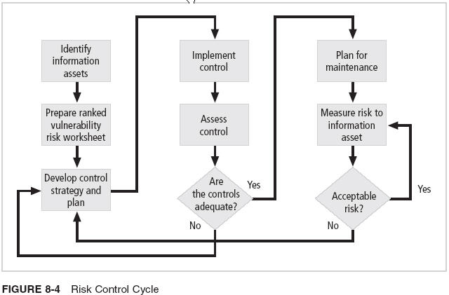
Risk Control Cycle

Slide 20
Feasibility Studies and Cost Benefit Analysis
Before deciding on the strategy for a specific vulnerability, all readily accessible information about the consequences of the vulnerability must be explored
  “What are the advantages of implementing a control as opposed to the disadvantages of implementing the control?”
There are a number of ways to determine the advantage or disadvantage of a specific control
The primary means are based on the value of the information assets that it is designed to protect
Notes:
Feasibility Studies and Cost Benefit Analysis
Before deciding on the strategy for a specific vulnerability, all readily accessible information about the consequences of the vulnerability must be explored.
“What are the advantages of implementing a control as opposed to the disadvantages of implementing the control?”
There are a number of ways to determine the advantage or disadvantage of a specific control.
The primary means is to determine the value of the information assets that it is designed to protect.

Slide 21
Cost Benefit Analysis (CBA)
The criterion most commonly used when evaluating a project that implements information security controls and safeguards is economic feasibility
Organizations are urged to begin a cost benefit analysis by evaluating the worth of the information assets to be protected and the loss in value if those information assets are compromised
This decision-making process is called a cost benefit analysis or an economic feasibility study
Notes:
Cost Benefit Analysis (CBA)
The criterion most commonly used when evaluating a project that implements information security controls and safeguards is economic feasibility.
Organizations are urged to begin a cost benefit analysis by evaluating the worth of the information assets to be protected and the loss in value if those information assets are compromised by the exploitation of a specific vulnerability.
This decision-making process is called a cost benefit analysis or an economic feasibility study.

Slide 22
Cost
Just as it is difficult to determine the value of information, it is difficult to determine the cost of safeguarding it
Some of the items that affect the cost of a control or safeguard include:
  Cost of development or acquisition of hardware, software, and services
  Training fees
  Cost of implementation
  Service costs
  Cost of maintenance
Notes:
Cost
Just as it is difficult to determine the value of information, it is difficult to determine the cost of safeguarding it.
Some of the items that affect the cost of a control or safeguard include:
Cost of development or acquisition of hardware, software, and services
Training fees
Cost of implementation
Service costs
Cost of maintenance

Slide 23
Benefit
Benefit is the value to the organization of using controls to prevent losses associated with a specific vulnerability
The benefit is usually determined by valuing the information asset or assets exposed by the vulnerability and then determining how much of that value is at risk and how much risk there is for the asset
This is expressed as the annualized loss expectancy (ALE)
Notes:
Benefit
Benefit is the value to the organization of using controls to prevent losses associated with a specific vulnerability.
The benefit is usually determined by valuing the information asset or assets exposed by the vulnerability and then determining how much of that value is at risk and how much risk there is for the asset.
This is expressed as the annualized loss expectancy (ALE).

Slide 24
Asset Valuation
Asset valuation is the process of assigning financial value or worth to each information asset
The value of information differs within organizations and between organizations, based on the characteristics of information and the perceived value of that information
The valuation of assets involves estimation of real and perceived costs associated with the design, development, installation, maintenance, protection, recovery, and defense against loss and litigation
Notes:
Asset Valuation
Asset valuation is the process of assigning financial value or worth to each information asset.
The value of information differs within organizations and between organizations, based on the characteristics of information and the perceived value of that information.
The valuation of assets involves estimation of real and perceived costs associated with the design, development, installation, maintenance, protection, recovery, and defense against loss and litigation.

Slide 25
Asset Valuation Components
Some of the components of asset valuation include:
  Value retained from the cost of creating the information asset
  Value retained from past maintenance of the information asset
  Value implied by the cost of replacing the information
  Value from providing the information
  Value acquired from the cost of protecting the information
  Value to owners
  Value of intellectual property
  Value to adversaries
  Loss of productivity while the information assets are unavailable
  Loss of revenue while information assets are unavailable
Notes:
Asset Valuation Components
Some of the components of asset valuation include:
Value retained from the cost of creating the information asset
Value retained from past maintenance of the information asset
Value implied by the cost of replacing the information
Value from providing the information
Value acquired from the cost of protecting the information
Value to owners
Value of intellectual property
Value to adversaries
Loss of productivity while the information assets are unavailable
Loss of revenue while information assets are unavailable

Slide 26
Asset Valuation Approaches
An organization must be able to place a dollar value on each information asset it owns, based on:
  How much did it cost to create or acquire?
  How much would it cost to recreate or recover?
  How much does it cost to maintain?
  How much is it worth to the organization?
  How much is it worth to the competition?
Notes:
Asset Valuation Approaches
An organization must be able to place a dollar value on each collection of information and the information assets it owns, based on:
How much did it cost to create or acquire this information?
How much would it cost to recreate or recover this information?
How much does it cost to maintain this information?
How much is this information worth to the organization?
How much is this information worth to the competition?
Next the organization examines the potential loss that could occur from the exploitation of vulnerability or a threat occurrence.
This process results in the estimate of potential loss per risk.
The questions that must be asked here include:
What damage could occur, and what financial impact would it have?
What would it cost to recover from the attack, in addition to the financial impact of damage?
What is the single loss expectancy for each risk?

Slide 27
Asset Valuation Approaches (continued)
Potential loss is that which could occur from the exploitation of vulnerability or a threat occurrence
The questions that must be asked include:
  What loss could occur, and what financial impact would it have?
  What would it cost to recover from the attack, in addition to the financial impact of damage?
  What is the single loss expectancy for each risk?

Slide 28
Asset Valuation Techniques
A single loss expectancy, or SLE, is the calculation of the value associated with the most likely loss from an attack
SLE is a calculation based on the value of the asset and the expected percentage of loss that would occur from a particular attack:
  SLE = asset value (AV) x exposure factor (EF)
  Where EF = the percentage loss that would occur from a given vulnerability being exploited
This information is usually estimated
Notes:
Asset Valuation Techniques
A single loss expectancy, or SLE, is the calculation of the value associated with the most likely loss from an attack.
It is a calculation based on the value of the asset and the expected percentage of loss that would occur from a particular attack:
SLE = asset value (AV) x exposure factor (EF)
Where EF = the percentage loss that would occur from a given vulnerability being exploited.
This information is usually estimated.
In most cases, the probability of a threat occurring is usually a loosely derived table indicating the probability of an attack from each threat type within a given time frame.
This value is commonly referred to as the ARO, or annualized rate of occurrence.
In order to standardize calculations, you convert the rate to a yearly (annualized) value.
This is expressed as the probability of a threat occurrence.

Slide 29
Asset Valuation Techniques (continued)
In most cases, the probability of a threat occurring is the probability of loss from an attack within a given time frame
This value is commonly referred to as the ARO, or annualized rate of occurrence
ALE = SLE * ARO
Management of Information Security, 2nd ed. - Chapter 8
Slide <number>

Slide 30
The Cost Benefit Analysis (CBA) Formula
CBA determines whether or not a control alternative is worth its associated cost
CBAs may be calculated before a control or safeguard is implemented, to determine if the control is worth implementing, or calculated after controls have been implemented and have been functioning for a time:
  CBA = ALE(prior) – ALE(post) – ACS
  ALE (prior to control) is the annualized loss expectancy of the risk before the implementation of the control
  ALE (post-control) is the ALE examined after the control has been in place for a period of time
  ACS is the annual cost of the safeguard
Notes:
The Cost Benefit Analysis (CBA) Formula
CBA determines whether or not a control alternative is worth its associated cost.
CBAs may be calculated before a control or safeguard is implemented, to determine if the control is worth implementing, or calculated after controls have been implemented and have been functioning for a time.
CBA = ALE(prior) – ALE(post) – ACS
ALE(prior to control) is the annualized loss expectancy of the risk before the implementation of the control.
ALE(post control) is the ALE examined after the control has been in place for a period of time.
ACS is the annual cost of the safeguard.

Slide 31
Other Feasibility Approaches
Organizational feasibility analysis examines how well the proposed information security alternatives will contribute to the operation of an organization
Operational feasibility addresses user acceptance and support, management acceptance and support, and the overall requirements of the organization’s stakeholders
Notes:
Other Feasibility Approaches
Organizational feasibility analysis examines how well the proposed information security alternatives will contribute to the operation of an organization.
Operational feasibility addresses user acceptance and support, management acceptance and support, and the overall requirements of the organization’s stakeholders.
Technical feasibility examines whether or not the organization has or can acquire the technology to implement and support the alternatives.
Political feasibility defines what can and cannot occur based on the consensus and relationships between the communities of interest.

Slide 32
Other Feasibility Approaches (continued)
Technical feasibility examines whether or not the organization has or can acquire the technology to implement and support the alternatives
Political feasibility defines what can and cannot occur based on the consensus and relationships between the communities of interest

Slide 33
Alternatives to Feasibility Analysis
Benchmarking
Due care and due diligence
Best business practices
Gold standard
Government recommendations
Baseline

Slide 34
Benchmarking
Benchmarking is seeking out and studying the practices from other organizations that produce the results desired, and then measuring the differences between the way the organizations conduct business
When benchmarking, an organization typically uses one of two measures to compare practices:
  Metrics-based measures are comparisons based on numerical standards
  Process-based measures are generally less focused on numbers and are more strategic
Notes:
Benchmarking
Benchmarking is the process of seeking out and studying the practices used in other organizations that produce the results you desire in your organization.
An organization typically benchmarks by selecting a measure with which to compare itself with the other organizations in its market.
The organization then measures the difference in the way it conducts business and the way the other organizations conduct business.
When benchmarking, an organization typically uses one of two measures to compare practices: metrics-based measures or process-based measures.
Metrics-based measures are comparisons based on numerical standards, such as:
Numbers of successful attacks
Staff hours spent on systems protection
Dollars spent on protection
Numbers of security personnel
Estimated value in dollars of the information lost in successful attacks
Loss in productivity hours associated with successful attacks
Process-based measures are generally less focused on numbers and are more strategic.
For each of the areas the organization is interested in benchmarking, process based measures enable the companies to examine the activities an individual company performs in pursuit of its goal, rather than the specifics of how goals are attained.
The primary focus is the method the organization uses to accomplish a particular process, rather than the outcome.
In the field of information security, two categories of benchmarks are used:
standards of due care and due diligence, and
best practices.
Within best practices, the gold standard is a subcategory of practices that are typically viewed as “the best of the best.”

Slide 35
Benchmarking (continued)
In the field of information security, two categories of benchmarks are used:
  Standards of due care and due diligence
  Best practices
Within best practices, the gold standard is a subcategory of practices that are typically viewed as “the best of the best”

Slide 36
Due Care and Due Diligence
For legal reasons, an organization may be forced to adopt a certain minimum level of security
When organizations adopt levels of security for a legal defense, they may need to show that they have done what any prudent organization would do in similar circumstances
  This is referred to as a standard of due care
Due diligence is the demonstration that the organization is persistent in ensuring that the implemented standards continue to provide the required level of protection
Notes:
Due Care and Due Diligence.
For legal reasons, an organization may be forced to adopt a certain minimum level of security.
When organizations adopt levels of security for a legal defense, they may need to show that they have done what any prudent organization would do in similar circumstances. This is referred to as a standard of due care.
Due diligence is the demonstration that the organization is persistent in ensuring that the implemented standards continue to provide the required level of protection.

Slide 37
Best Business Practices
Security efforts that seek to provide a superior level of performance are referred to as best business practices
Best security practices are those that are among the best in the industry, balancing access to information with adequate protection, while maintaining a solid degree of fiscal responsibility
Companies with best practices may not be the best in every area, but may simply have established an extremely high-quality or successful security effort in one or more area
Notes:
Best Business Practices
Security efforts that seek to provide a superior level of performance are referred to as best business practices.
Best security practices are those that are among the best in the industry, balancing access to information with adequate protection, while maintaining a solid degree of fiscal responsibility.
Companies with best practices may not be the best in every area, but may simply have established an extremely high quality or successful security effort in one or more area.

Slide 38
The Gold Standard
Even the best business practices are not sufficient for some organizations
These organizations aspire to set the standard by implementing the most protective, supportive, and yet fiscally responsible standards they can
The gold standard is a defining level of performance that demonstrates a company’s industrial leadership, quality, and concern for the protection of information
Seeking the gold standard is a method of striving for excellence
Notes:
The Gold Standard
Even the best business practices are not sufficient for some organizations. These organizations aspire to set the standard by implementing the most protective, supportive, and yet fiscally responsible standards they can.
The gold standard is a defining level of performance that demonstrates a company’s industrial leadership, quality, and concern for the protection of information.
Seeking the gold standard is a method of striving for excellence.

Slide 39
Applying Best Practices
When considering best practices for adoption, address the following questions:
  Does your organization resemble the organization that is implementing the best practice under consideration?
  Is your organization in a similar industry?
  Does your organization face similar challenges?
  Is your organizational structure similar to the organization from which you are modeling the best practices?
  Can your organization expend resources that are in line with the requirements of the best practice?
  Is your organization in a similar threat environment as the one cited in the best practice?
Notes:
Applying Best Practices
When considering best practices for adoption, address the following questions:
Does your organization resemble the organization that is implementing the best practice under consideration?
Is your organization in a similar industry?
Does your organization face similar challenges?
Is your organizational structure similar to the organization from which you are modeling the best practices?
Can your organization expend resources that are in line with the requirements of the best practice?
Is your organization in a similar threat environment as the one cited in the best practice?

Slide 40
Problems with Benchmarking and Best Practices
Organizations don’t talk to each other
No two organizations are identical
Best practices are a moving target
Simply knowing what was going on a few years ago doesn’t necessarily indicate what to do next
Notes:
Problems with Benchmarking and Best Practices
1) Organizations don’t talk to each other.
2) No two organizations are identical.
3) Best practices are a moving target.
4) Simply knowing what was going on a few years ago, doesn’t necessarily indicate what to do next.

Slide 41
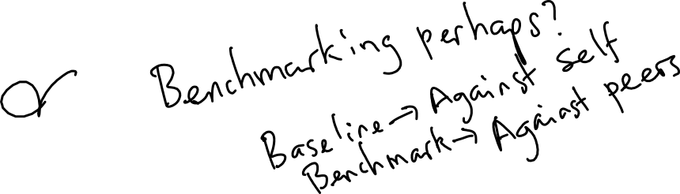

Baselining
Baselining is the analysis of measures against established standards
In information security, baselining is the comparison of security activities and events against the organization’s future performance
The information gathered for an organization’s first risk assessment becomes the baseline for future comparisons
Notes:
Baselining
Baselining is the analysis of measures against established standards.
In information security, baselining is the comparison of security activities and events against the organization’s future performance.
The information gathered for an organization’s first risk assessment becomes the baseline for future comparisons.

Slide 42
Documenting Results
When the risk management program of an organization has been completed, the result is that a series of proposed controls are prepared, each of which is justified by one or more feasibility or rationalization approaches
At a minimum, each information asset-threat pair should have a documented control strategy that clearly identifies any residual risk remaining after the proposed strategy has been executed
Some organizations document the outcome of the control strategy for each information asset-threat pair in an action plan that includes concrete tasks, each with accountability assigned to an organizational unit or to an individual
Notes:
Documenting Results
When the risk management program of an organization has been completed, the result is that a series of proposed controls are prepared, each of which is justified by one or more feasibility or rationalization approaches.
At a minimum, each information asset-threat pair should have a documented control strategy that clearly identifies any residual risk remaining after the proposed strategy has been executed.
Some organizations document the outcome of the control strategy for each information asset-threat pair in an action plan that includes concrete tasks, each with accountability assigned to an organizational unit or to an individual.

Slide 43
Qualitative Measures
Quantitative assessment performs asset valuation with actual values or estimates
An organization could determine that it cannot put specific numbers on these values
Organizations could use qualitative assessments instead, using scales instead of specific estimates
Notes:
Qualitative Measures
Quantitative assessment performs asset valuation with actual values or estimates.
An organization could determine that it cannot put specific numbers on these values.
Organizations could use qualitative assessments instead, using scales instead of specific estimates.

Slide 44
Microsoft Risk Management Approach
Microsoft Corp. also promotes a risk management approach
Four phases in the MS InfoSec risk management process:
  Assessing risk
  Conducting decision support
  Implementing controls
  Measuring program effectiveness

Slide 45
Microsoft Risk Management Approach:
Assessing Risk
Identification and prioritization of risks facing the organization
  Plan data gathering – Discuss keys to success and preparation guidance
  Gather risk data – Outline the data collection process and analysis
  Prioritize risks – Outline prescriptive steps to qualify and quantify risks

Slide 46
Microsoft Risk Management Approach:
Conducting Decision Support
Identify and evaluate controls available to the organization
  Define functional requirements – Create the necessary requirements to mitigate risks
  Select possible control solutions – Outline approach to identify mitigation solutions
  Review solution – Evaluate proposed controls against functional requirements

Slide 47
Microsoft Risk Management Approach:
Conducting Decision Support (continued)
Identify and evaluate controls available to the organization (continued)
  Estimate risk reduction – Endeavor to understand reduced exposure or probability of risks
  Estimate solution cost – Evaluate direct and indirect costs associated with mitigation solutions
  Select mitigation strategy – Complete cost-benefit analysis to identify the most cost-effective mitigation solution

Slide 48
Microsoft Risk Management Approach:
Implementing Controls
Deployment and operation of the controls selected from the cost-benefit analyses and other mitigating factors from the previous step
  Seek holistic approach – Incorporate people, process, and technology in mitigation solution
  Organize by defense-in-depth – Arrange mitigation solutions across the business

Slide 49
Microsoft Risk Management Approach:
Measuring Program Effectiveness
Ongoing assessment of the effectiveness of the risk management program
  Develop risk scoreboard – Understand risk posture and progress
  Measure program effectiveness – Evaluate the risk management program for opportunities to improve

Slide 50
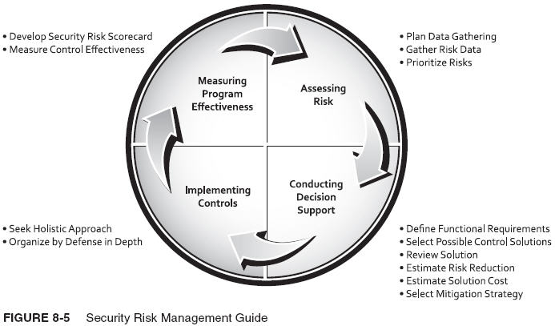
Microsoft Security Risk Management Guide

Slide 51
Microsoft Risk Management Approach
Additional information is available at:
  www.microsoft.com/technet/security/topics/complianceandpolicies/secrisk/default.mspx

Slide 52
Summary
Risk Control Strategies
Risk Control Strategy Selection
Categories of Controls
Feasibility Studies and Cost-Benefit Analysis
Risk Management Discussion Points
Recommended Risk Control Practices
The Microsoft Risk Management Approach
Notes:
Summary
Risk Control Strategies
Risk Control Strategy Selection
Categories of Controls
Feasibility Studies and Cost-Benefit Analysis
Risk Management Discussion Points
Recommended Risk Control Practices

